Slide 1
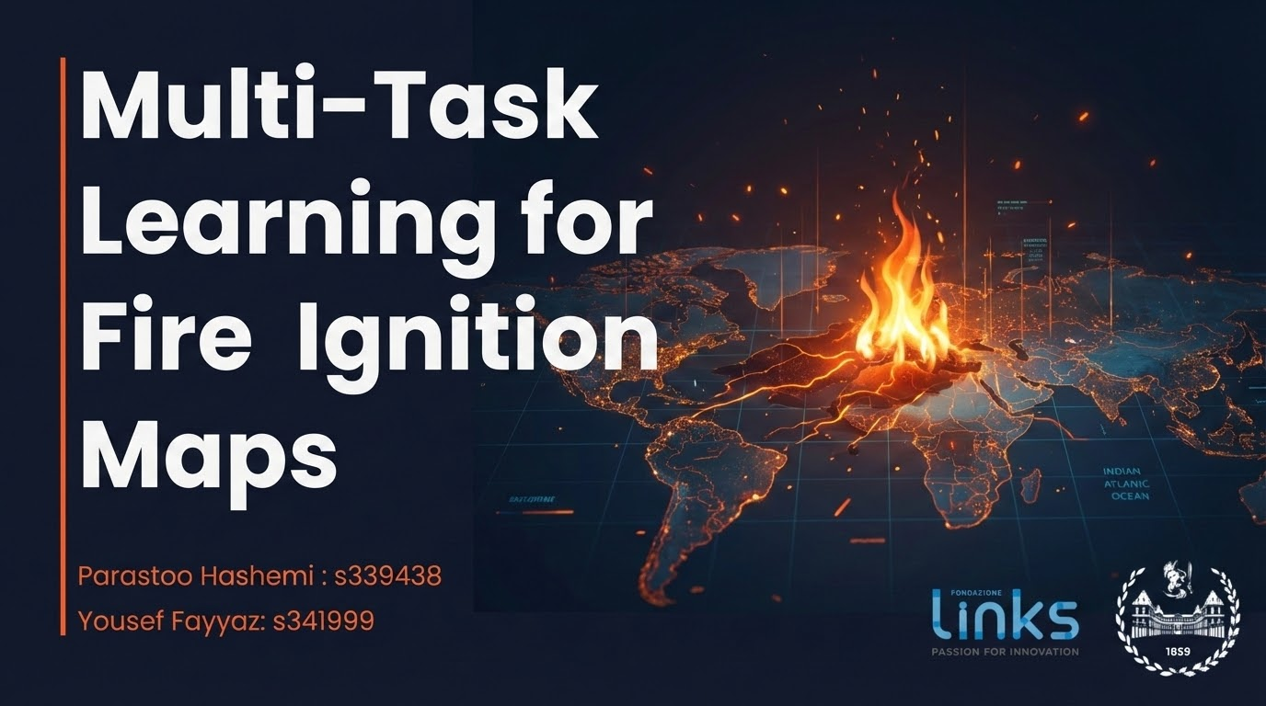
Notes:
Good morning everyone. My name is Parastoo Hashemi, and my teammate Yousef Fayyaz, we’re here to present the progress for our project In this presentation, we focus on our project’s value proposition, objectives, research questions, methodology, and experimental results.

Slide 2
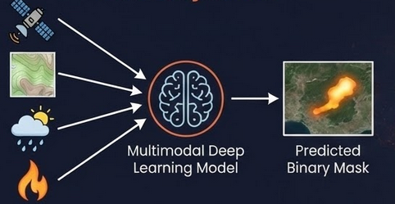
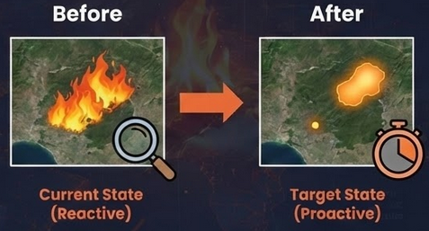
Project Objective
Core Objective
To develop a multimodal deep learning model capable of Predicting the final burned area extent right at the moment of ignition, using only pre-fire multimodal data that fused into a multimodal model
Input: Pre-fire environmental data (Satellite, Topography, Weather) + Ignition Point.
Output: Predicted binary mask of the final burned area.
The Paradigm Shift
Current State (Reactive): Remote sensing is primarily used for post-event damage assessment.
Target State (Proactive): To estimate the spread of fire immediately to allocate resources immediately during the "Golden Hour".
Notes:
Our project aims to predict the final burned-area extent right at the moment of ignition, using only pre-fire environmental information. Traditionally, remote sensing is reactive: we analyze damage after the fire is over.
What we are aiming for is a proactive setting, where we estimate spread immediately, during the first critical hour, when decisions still matter.

Slide 3




Value Proposition
Response Efficiency
Innovation & Scalability
Environmental Impact
The multimodal AI system generalizes across regions where Sentinel-2, Landsat, DEM, ERA5, and infrastructure layers are available.
The framework can be replicated globally, providing a reusable template for data-driven wildfire risk management.
Proactive predictions reduce environmental losses by enabling faster response before uncontrolled spread.
Fewer hectares burned → lower CO₂ emissions, preserved ecosystems, and reduced long-term regeneration costs.
Early burned-area forecasts help Civil Protection allocate firefighting teams, helicopters, and ground units efficiently.
Better situational awareness during the first critical hours improves containment and reduces operational risk.
Notes:
This approach creates value on three levels.
Environmentally, early estimates can reduce burned area and downstream emissions.
Operationally, they help Civil Protection position resources earlier, not react later.
And finally, the system is scalable, because all inputs are globally available and the pipeline can be reused elsewhere.

Slide 4
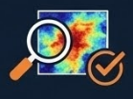
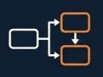
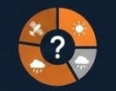
Research Questions
Can pre-fire multimodal data predict final burned area with sufficient accuracy to support early emergency decisions?
Does auxiliary-task learning improve spatial segmentation performance compared to single-task models?
What is the relative contribution of satellite, meteorological, and topographical modalities?
Notes:
Our research revolves around three key questions:
Can multimodal pre-fire data actually predict the final burned area with useful accuracy?
Which metrics actually reflect usefulness in a spatial emergency context?
And finally, which modalities matter most?

Slide 5
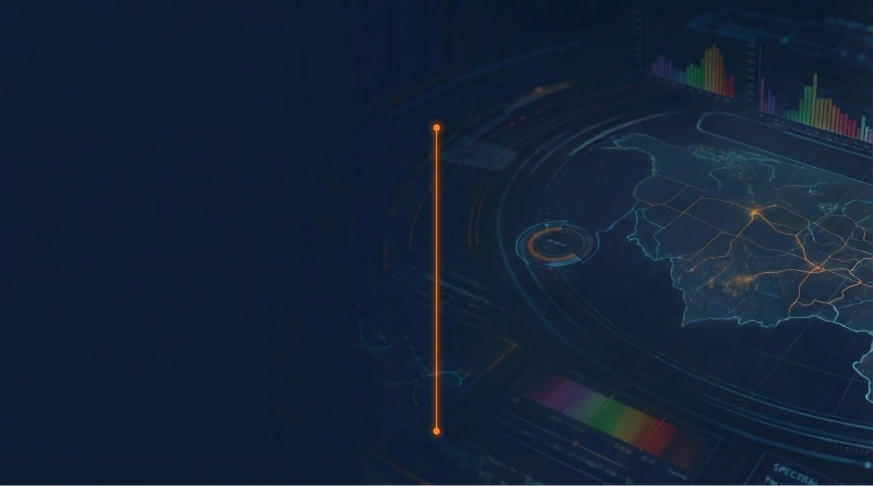
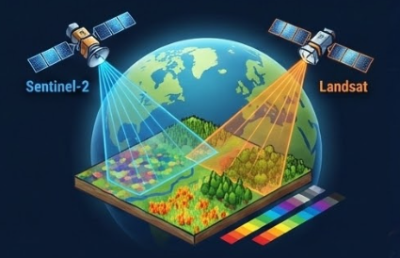
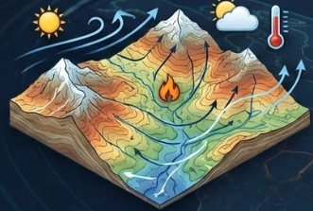
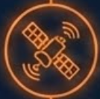




Pre-Fire Data: Satellite Imagery & Environmental Drivers
Satellite Imagery (Sentinel-2 & Landsat)
Environmental Drivers (DEM & ERA5)
Sentinel-2 Imagery: 12-band multispectral, 10-20m res.
why needed? captures immediate pre-fire condition
(vegetation & fuel availability)
Topograph (DEM): Terrain , slopes and valleys (30m res).
why needed? Fire spreads uphill, elevation is crucial for behavior.
Landsat Imagery: Extra spectral info (SWIR/NIR)
why needed? Sensitive to vegetation moisture and fuel dryness.
Complementary spectral response for fuel characterization.
ERA5 weather: Temperature & wind at ignition time.
why needed? Meteorological conditions are key drivers of fire expansion.
wind vectors provide essential dynamic information for propagation direction.
Notes:
Sentinel-2 is our main source—it provides 12 multispectral bands at 10 to 20 meters.
three bands of that are essential for describing the vegetation condition and fuel availability right before ignition. Landsat give us extra spectral information, especially in the SWIR and NIR bands, which are very sensitive to vegetation moisture and fuel dryness. For the environmental context, we have two important pieces of information.
The first one is the Digital Elevation Model, or DEM. This gives us the terrain around each fire — things like hills, slopes, and valleys.
Since fire spreads uphill and behaves differently depending on the landscape, elevation is a crucial factor.
The second part is the ERA5 weather data. For each fire, we extract the temperature and the wind components on the day of the pre-fire from Sentinel image. Wind direction and wind speed impact fire spread.

Slide 6
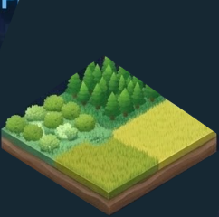
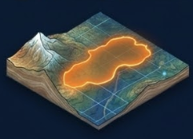

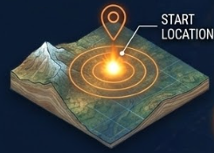
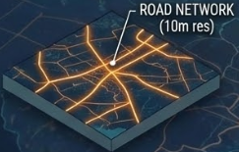
Ground-Truth Fire Labels
BURNED AREA MASK & IGNITION DATA
Land cover and Roads
Land cover map: Categorical mask of vegetation types (Forest, Shrub, Grassland, etc.).
why needed? Critical for estimating fuel type, Assists the model in differentiating propagation potential based on available fuel.
Burned Area Mask: Shape of the area that actually burned,
Binary Segmentation
(1 = burned, 0 = unburned)
why needed? Serve as a target label for supervised learning segmentation
Roads: Binary road mask (10m resolution).
why needed? Captures both human-caused ignition likelihood and fire break potential.
Ignition Data: The exact location where the fire started. (Binary marker), derived from Civil Protection point data.
why needed? The model learns how the fire is likely to spread from that specific starting position.
Notes:
For the ground truth, we work with two main pieces of information. The first is the burned-area mask. It shows the shape of the area that actually burned, which is polygon. The second is the ignition point, which marks the exact location where the fire started. So instead of only learning which areas are burnable, the model learns from which points the fire is likely to spread. For the landscape, we have two more inputs.
The first one is the landcover map, which basically tells us what type of vegetation is present..
Since different fuels burn differently, this helps the model understand how the environment might influence the fire.
The second input is the road network. Roads are important because many fires start near human activity, and they also act as barriers that can slow down or stop the spread.

Slide 7
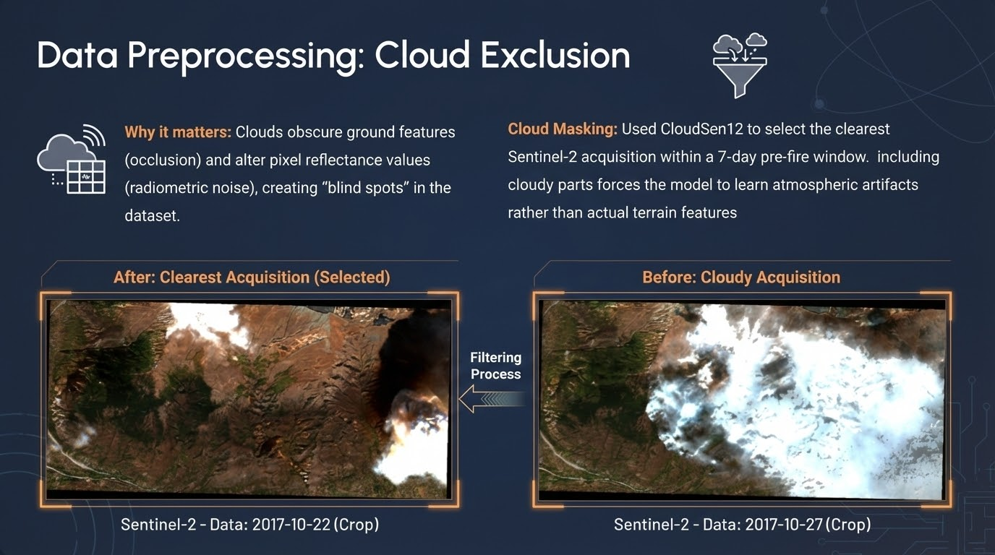
Notes:
Clouds are a major source of dataset contamination.
They hide critical terrain features and distort reflectance values.
We use CloudSen12 to automatically select the clearest acquisition within the seven-day
window.
The examples on this slide show why this is essential:
the selected image preserves full visibility, while the rejected one is heavily occluded.
This filtering step directly improves model reliability and reduces false learning.”

Slide 8
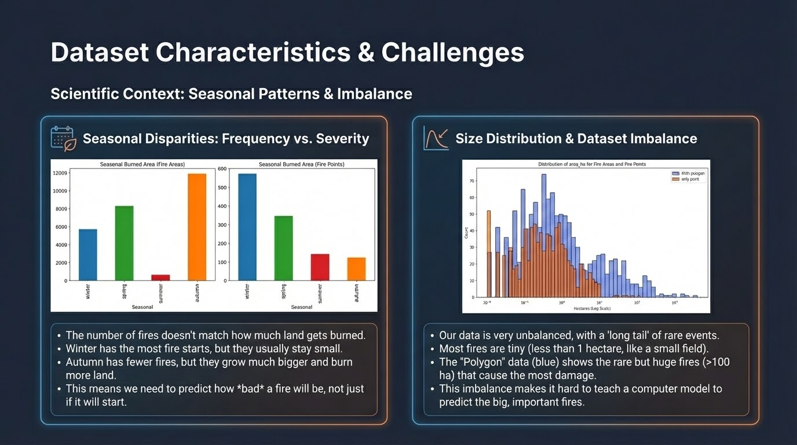
Notes:
Aim:
To show HOW dataset statistics 📈 shaped our modeling decisions
On the left:
Compare fire frequency with burned area across seasons
Winter: many fires, small
Autumn: rare, large
=> frequency / severity: not aligned
On the right:
Fire-size distribution
Follows a long-tail distribution
Most fires : small
Large fires: rare ==> major of damage
=>
accuracy(evaluation metric):
Misleading- insufficient
Model can look strong by predicting background
Object: decision making not detection
Emergency response, need where burn not weather a fire happened

Slide 9
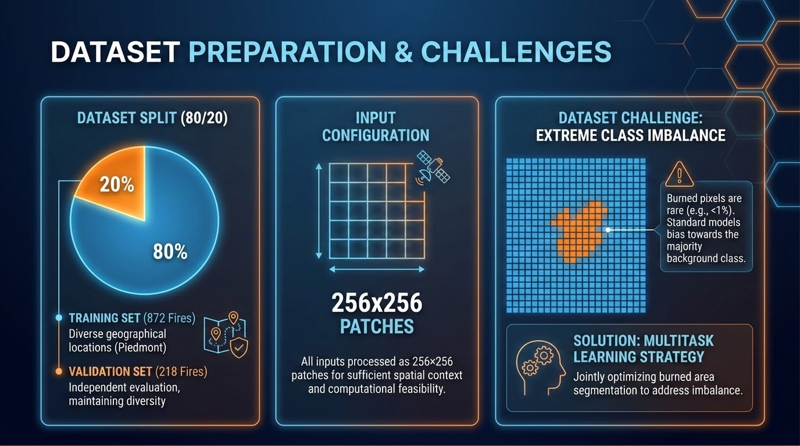
Notes:
split Dataset(entire fire events) using:
80-20 ratio between training/ validation
(This ensures validation measures generalization to unseen , not memorization.)
All input layers are processed as fixe patches
Size(large enough) to :
Capture patterns of burned area
Being efficient for training
Major challenge(dataset):
extreme class imbalance
Burned pixels < 1% of total pixels
=> bias toward predicting background

Slide 10
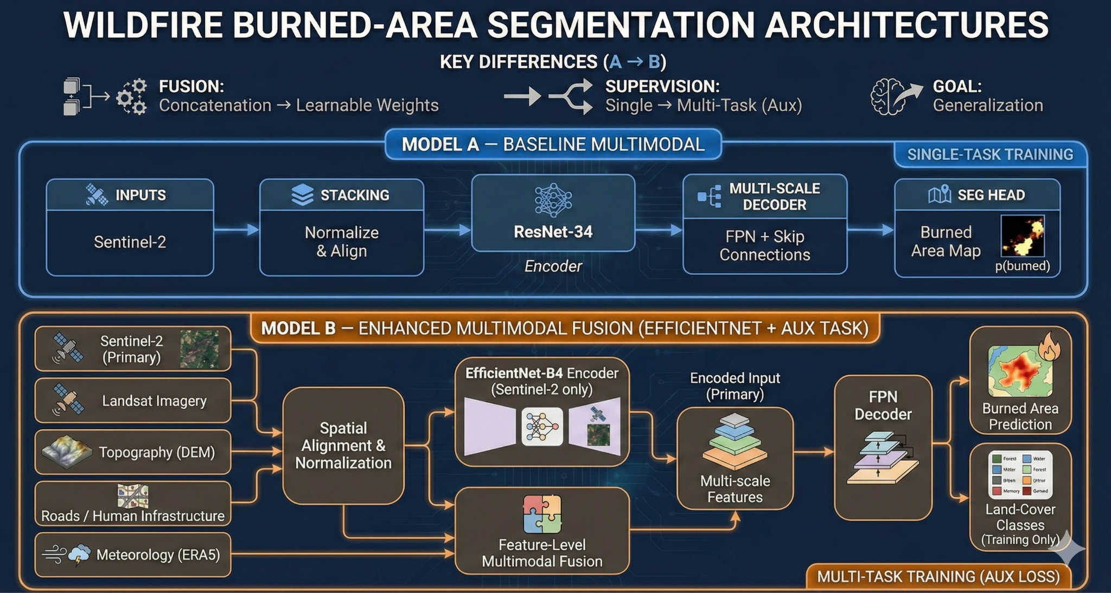

Slide 11
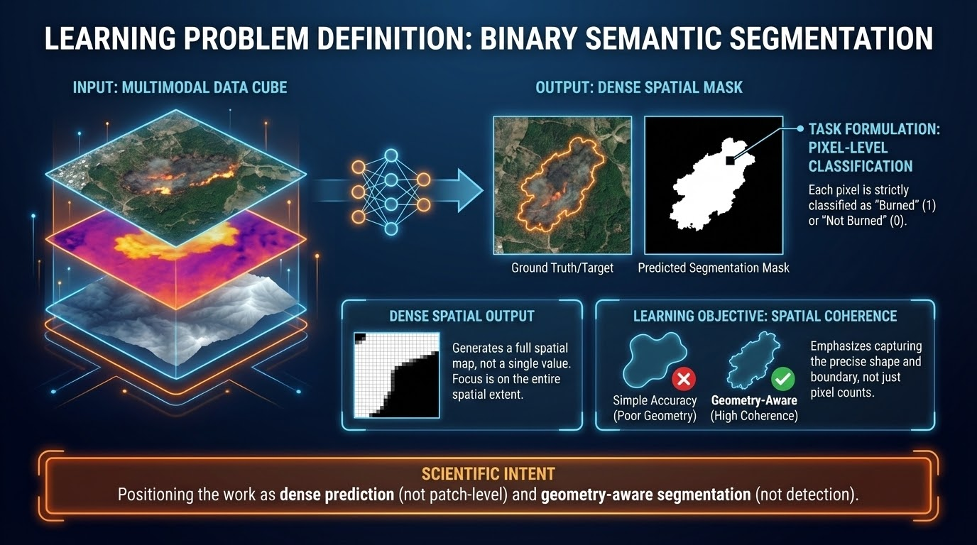
Notes:
Formulate(task): BSS (not classification/detection)
Input:
Multimodal data
layers are aligned
(...) are stacked into unified representation
Output:
Dense spatial mask
Each pixel classified (B/nB)
Not patch-level label or scalar prediction
Formulation:
1- geometry aware learning problem
Care about coherence, boundaries, shape
2- ensures output are usable for decision making rather than simple event detection.

Slide 12
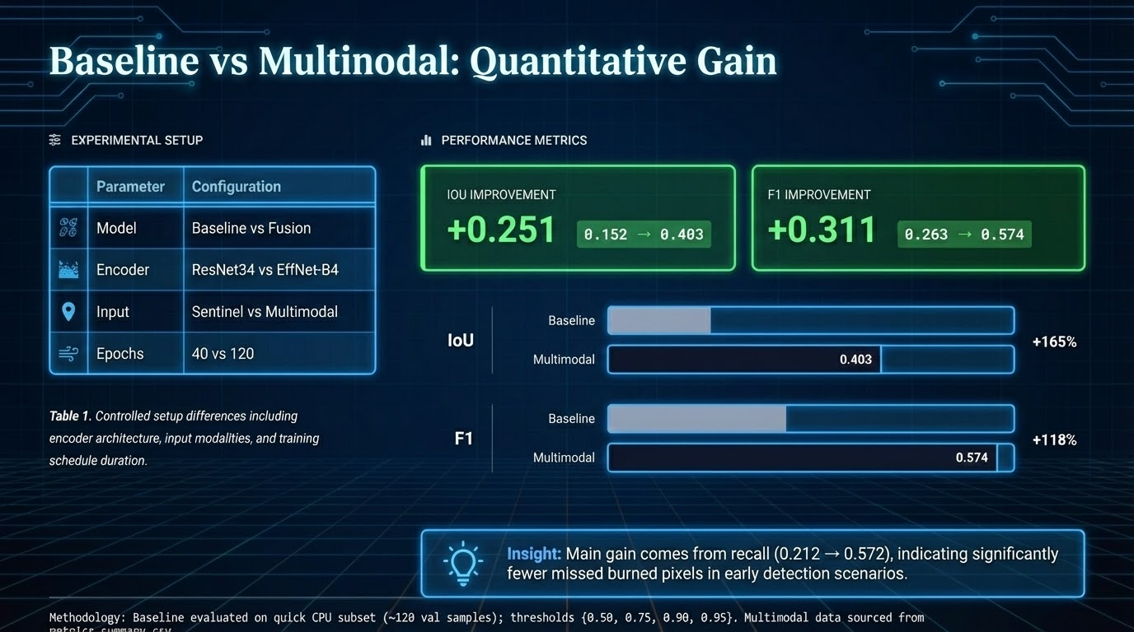
Notes:
Here I compare a baseline setup to the multimodal fusion approach, and I keep the comparison controlled. We switch from a baseline model to a fused model, and we also upgrade the encoder and training duration. The result is a clear improvement: IoU improves by +0.251, going from 0.152 to 0.403, and F1 improves by +0.311, from 0.263 to 0.574. The most important insight is that the main gain comes from recall, meaning the model misses far fewer burned pixels. In simple terms: multimodal fusion helps the model ‘see’ more of the final burned area early, instead of underestimating it.

Slide 13
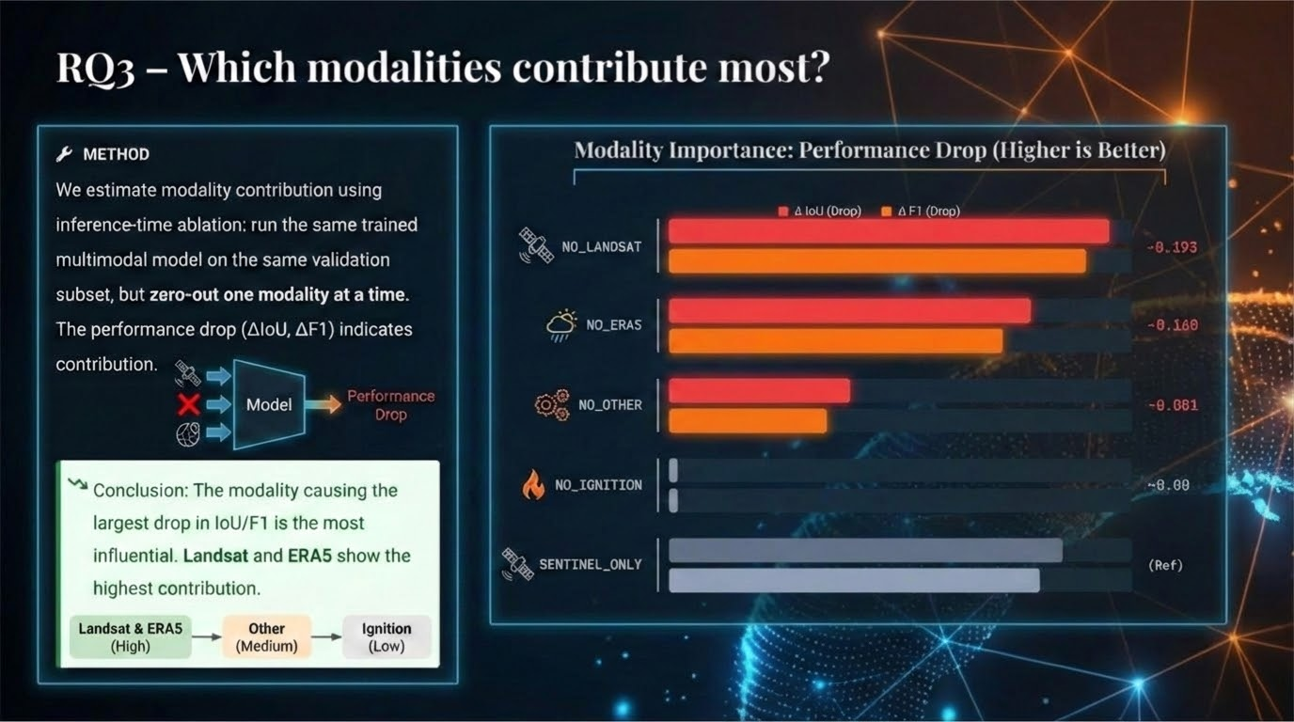

Slide 14
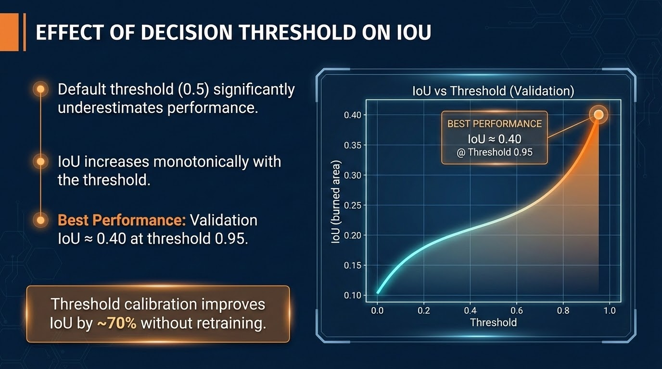
Notes:
This slide shows why the default threshold of 0.5 is not a good choice here. When we sweep thresholds on the validation set, IoU keeps improving as the threshold increases. The best IoU is about 0.40, and it happens around a threshold of 0.95. The key point is that we get a big improvement—around 70%—just by calibrating the threshold, without retraining the model. So this is a low-cost way to improve operational performance. The logic is: higher threshold means we only keep pixels the model is very confident about, which improves overlap with the true burned area

Slide 15
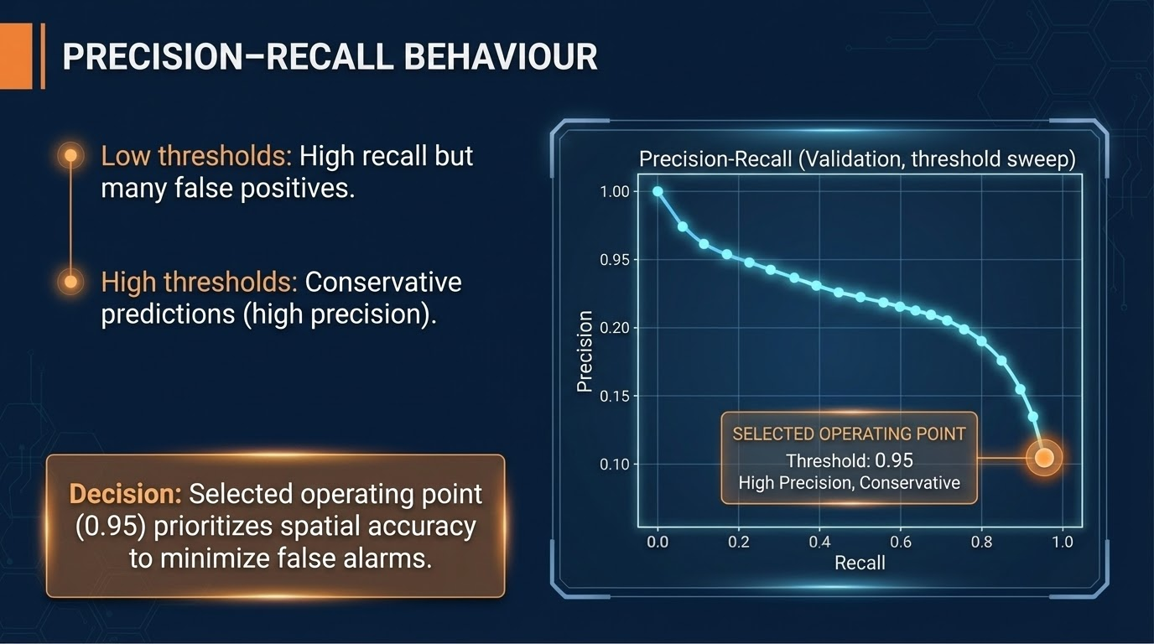
Notes:
This slide explains the trade-off behind the threshold choice. At low thresholds, the model marks a lot of pixels as burned, so recall is high, but we get many false positives. At high thresholds, predictions become conservative: fewer pixels are labeled burned, but precision increases. For emergency response, false alarms are expensive because they can misdirect teams and equipment. So we select 0.95 as the operating point to prioritize spatial accuracy and reduce false alarms. The message is: we are optimizing for decision-making in the early stage, not for perfect coverage of every boundary

Slide 16
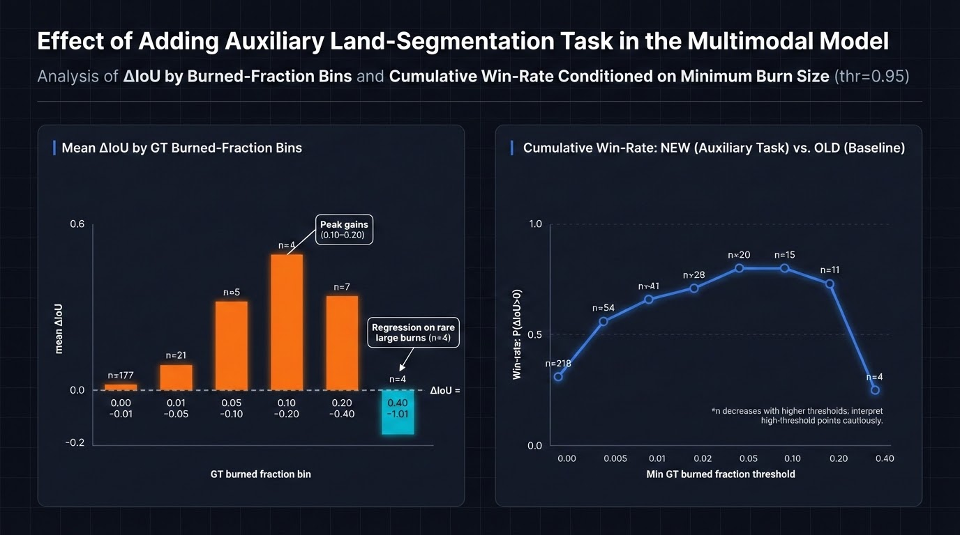

Slide 17

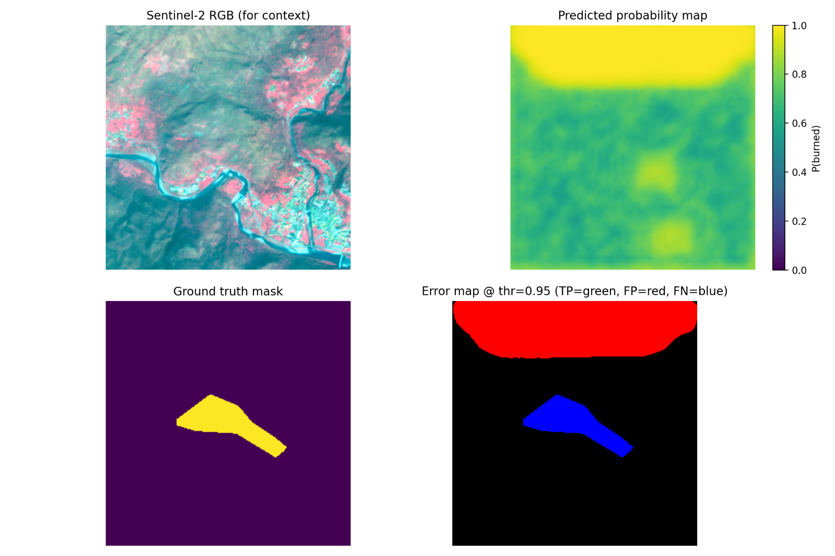
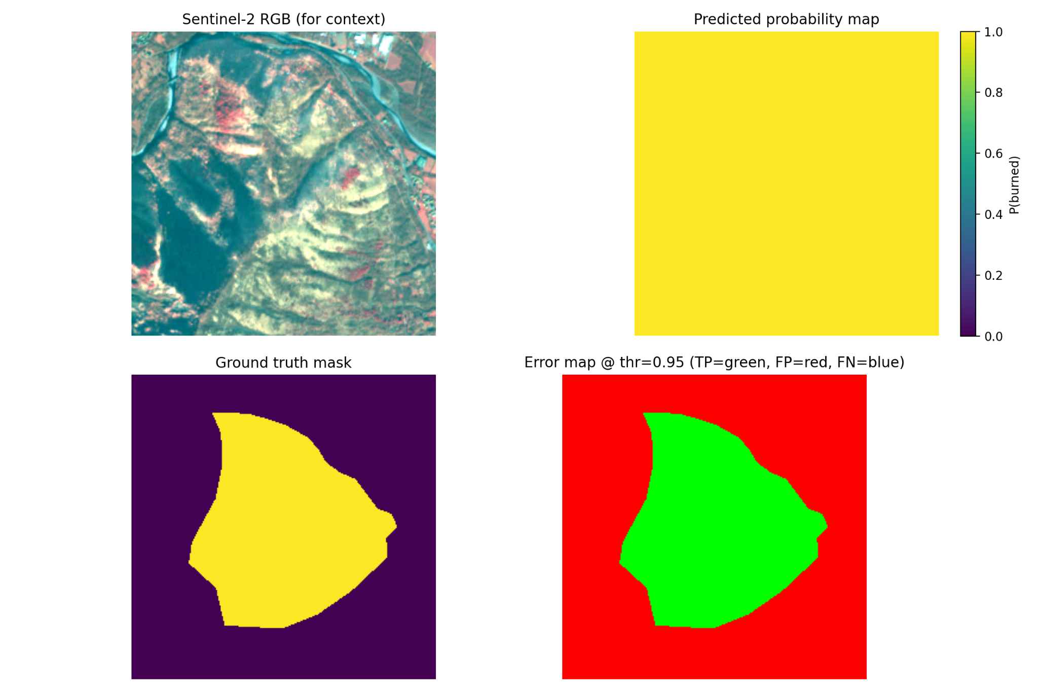

QUALITATIVE EVALUATION
SMALL / DIFFICULT FIRE
LARGE / WELL-DETECTED FIRE
Model shows conservative behavior, avoiding noise.
Large fires are detected with high spatial coherence.
Notes:
Now I show real examples to make the metrics feel concrete. Each example has four views: Sentinel-2 context image, the model probability map, the ground-truth burned mask, and an error map at threshold 0.95. On the left, for a small and difficult fire, the model behaves conservatively: it avoids noisy spread and focuses on the most confident burned region. This can mean missing some edges, but it reduces false alarms. On the right, for a large and well-detected fire, the model captures the shape with strong spatial coherence. This is important because large fires are high impact, and the model performs best where it matters most

Slide 18
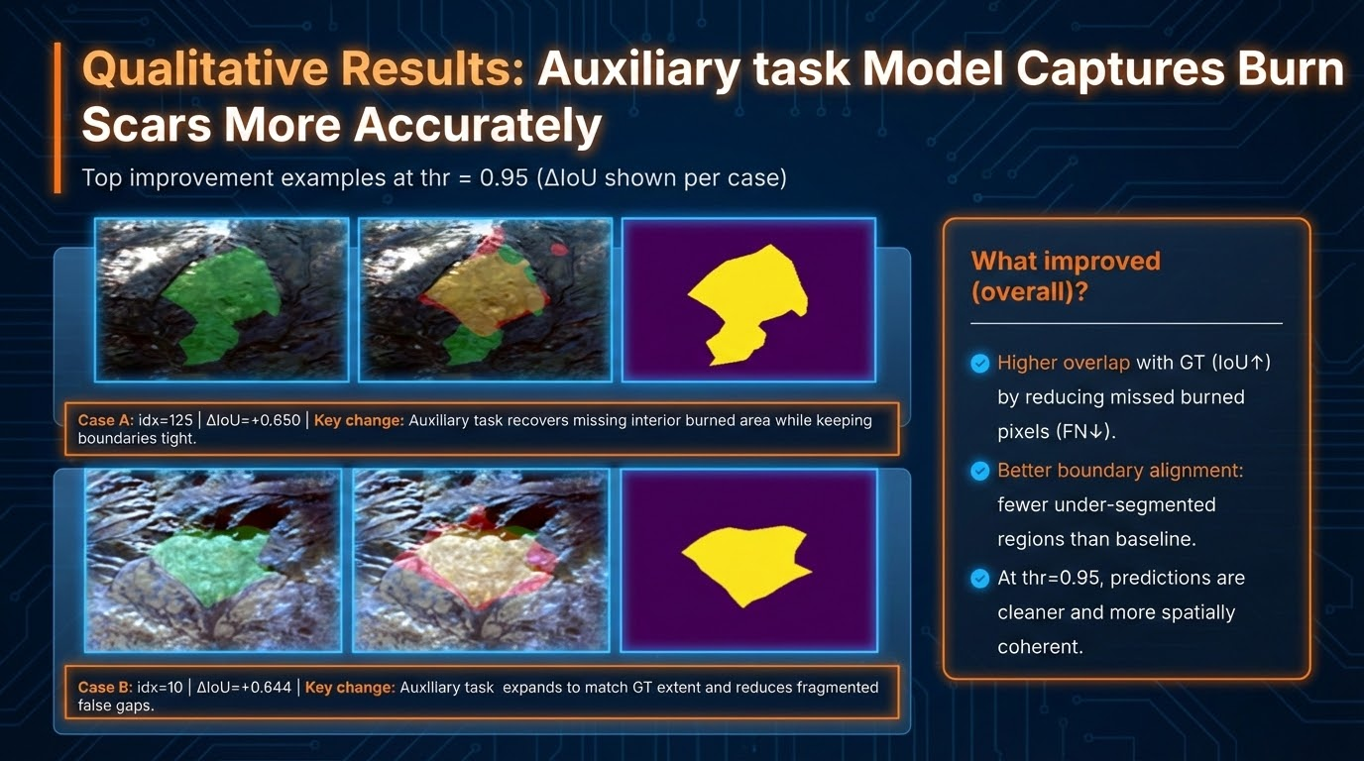

Slide 19
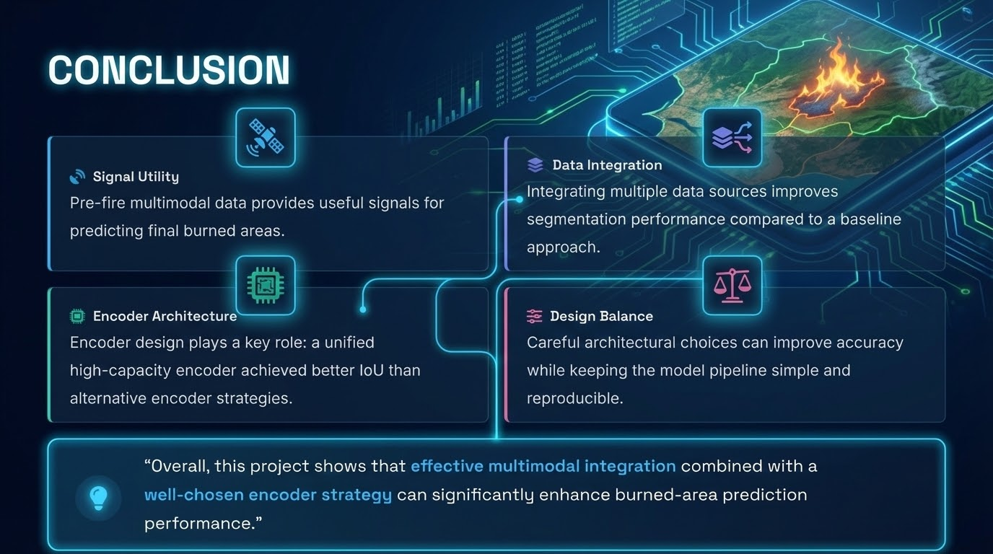
Notes:
I’ll wrap up with the core conclusions. First, pre-fire multimodal data contains useful signals for predicting final burned area. Second, integrating multiple data sources improves segmentation performance versus a baseline approach. Third, architecture matters: a strong, unified encoder gave better IoU than alternative encoder strategies. Finally, we kept a balance between accuracy and simplicity—so the pipeline stays reproducible and practical. The overall message is: effective multimodal fusion plus a good encoder strategy can significantly improve early burned-area prediction, which supports faster and smarter response decisions

Slide 20
